Slide 1
UAV-1
UAV-2
Full Duplex Ground Station

Slide 2
Inter-UAV Interference
Uplink UAV-i
Downlink UAV-j
Uplink Transmissions
SI
Downlink Transmissions
Full Duplex Ground Station

Slide 3
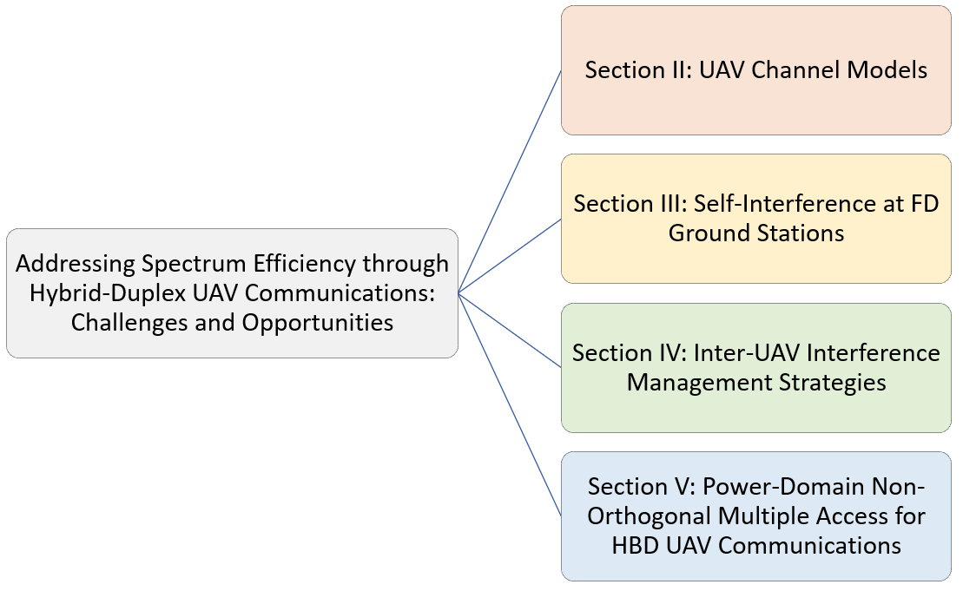

Slide 4
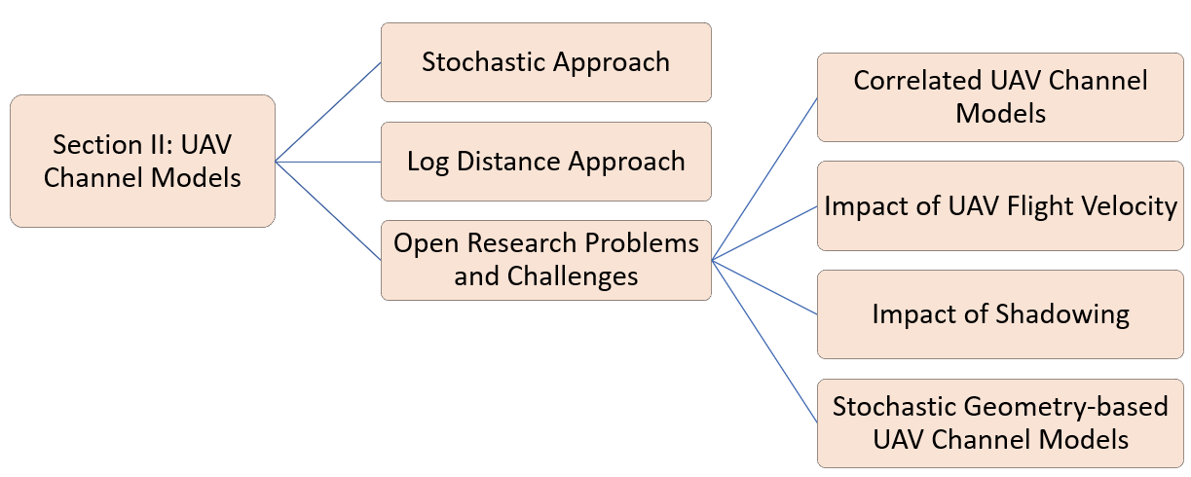

Slide 5
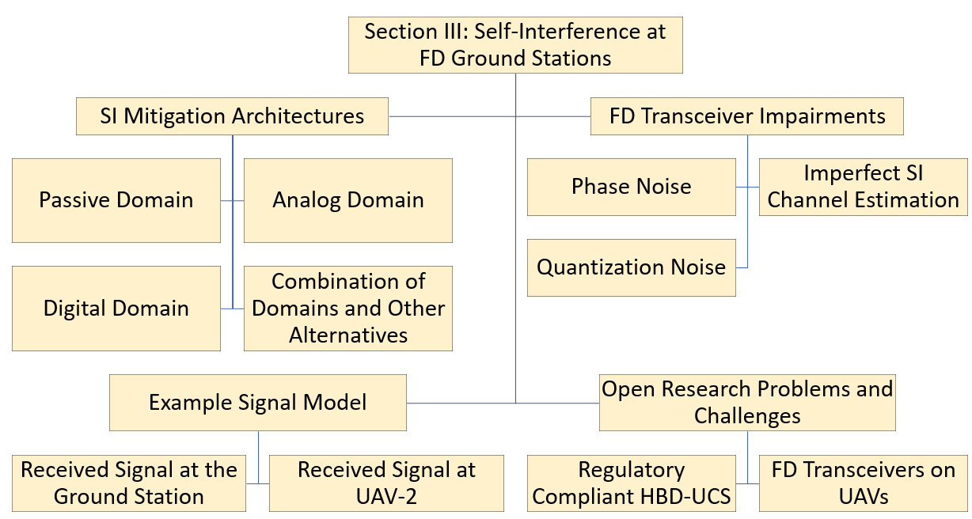

Slide 6
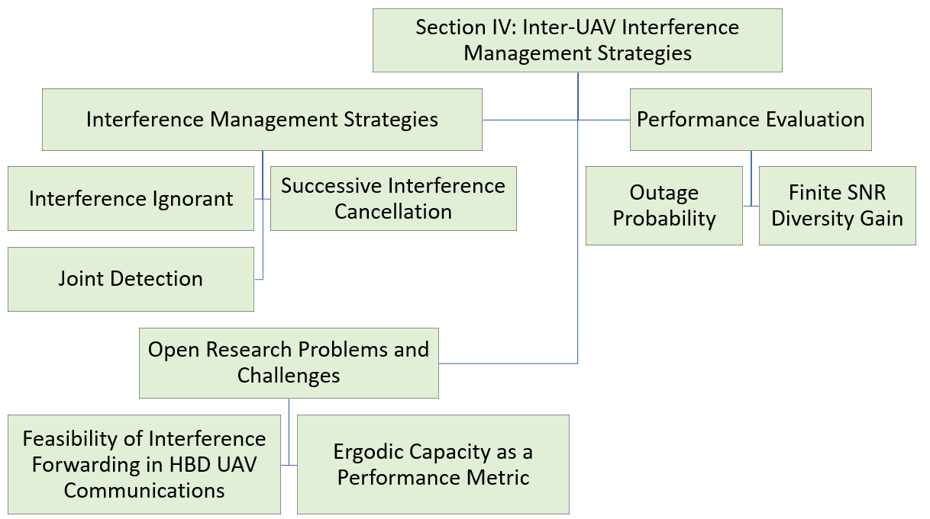

Slide 7
